Slide 1

Security Scan for OpenStack
Demo 4
16 March 2018
Clara De Paolis
Dilip Makwana
Hao Wu
Chi Zhang

Slide 2

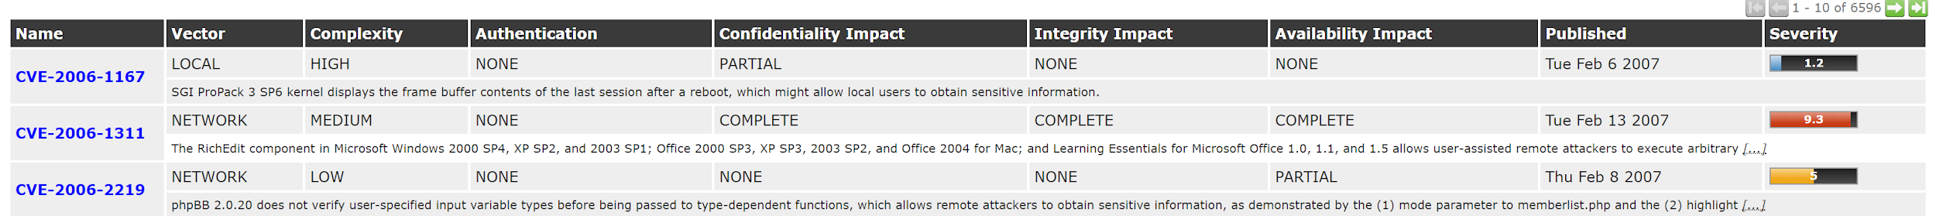
Sprint 4 goals
Improve results: include more information to more closely match “live” image scanners, e.g. OpenVAS:
Scaling up: need to run many scans at once
containers vs processes?
Notes:
Chi

Slide 3
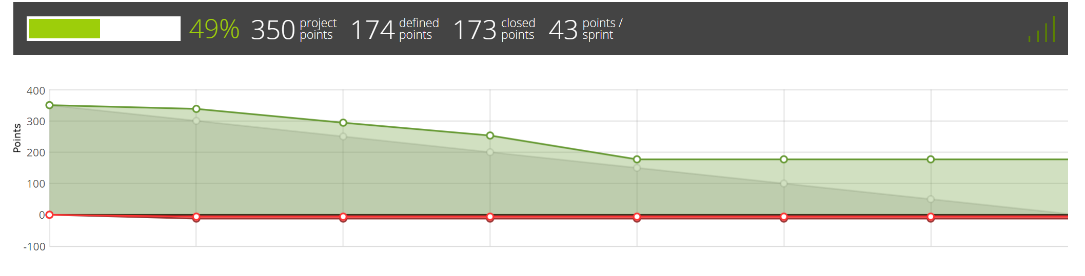
Progress Since Last Demo
Modify scanning library to provide more information based on NVD CVE database, especially vulnerability impact information
Set up local database to search applications’ CVE ID to prevent API rate limit issues
Implement scheduling for multiple scans using Celery and RabbitMQ
Get results from virus scan (vtscan) for windows images
Researched container-based scaling solution (Docker)
Notes:
Chi

Slide 4
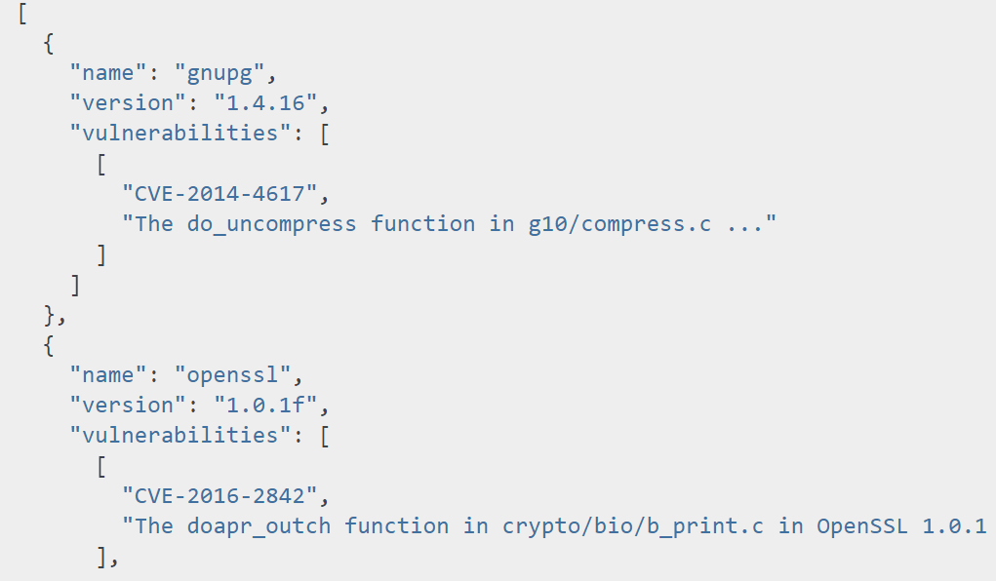
Old Vulnerability Results
vminspect vulnscan:
searches CVE database for vulnerabilities in installed applications
Notes:
Clara

Slide 5
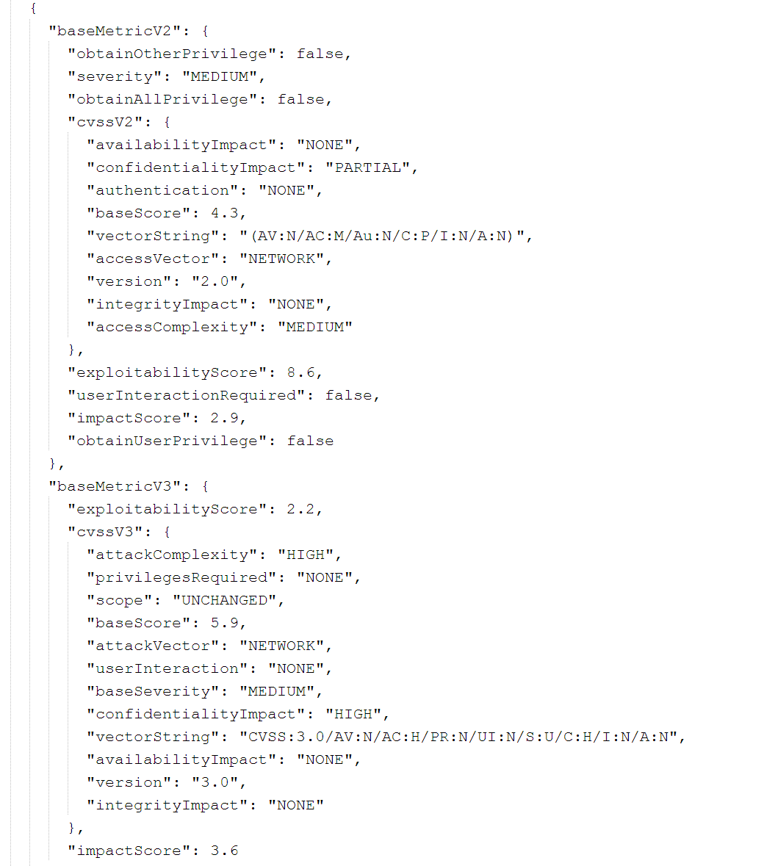
New Vulnerability Results
vminspect vulnscan:
searches CVE database for vulnerabilities in installed
Searches NVD database (locally) to augment information on vulnerability
Notes:
Clara

Slide 6
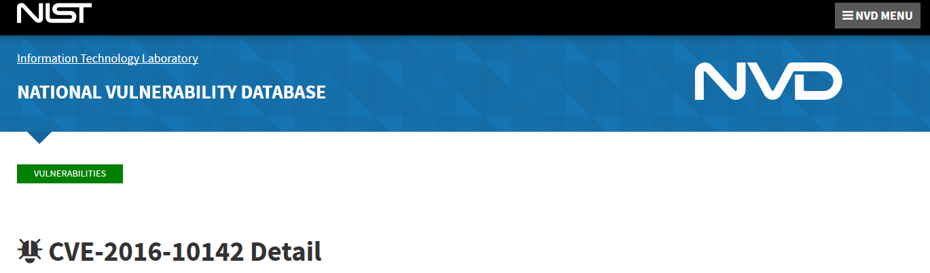
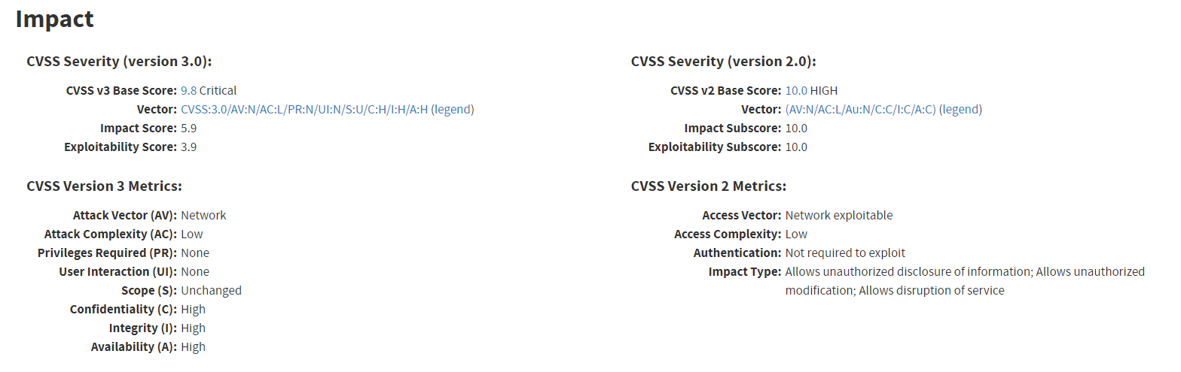
Vulnerability results
Notes:
Clara

Slide 7
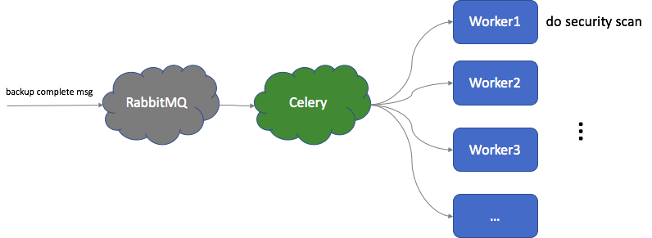
Celery & RabbitMQ worker queues
We have setup in place now to queue many (read ~100x) scans
Service can now be replicated across multiple VM easily with help of celery/rabbitmq setup
All of this scans save the result of scans in a shared disk (with identifying info such as workloadID, vmID, timestamp when scan was completed etc)
This setup is close to what we had discussed on our meeting with Trillio CTO
Notes:
Dilip

Slide 8
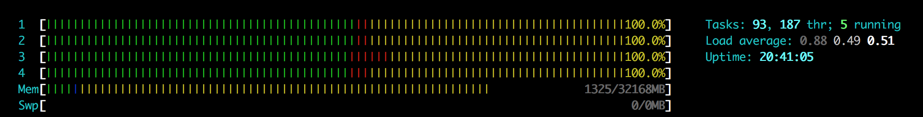
VM state when many scans are issued
VM is at 100% CPU utilization when scans are done and more scans are still pending in queue
Notes:
Dilip

Slide 9
Optimizations for vulnscan
Use local cve-search MongoDB database to prevent API rate limit being hit.
https://github.com/cve-search/cve-search
We will have to regularly update this local database to keep it accurate (use crontab task) .
Notes:
Chi

Slide 10
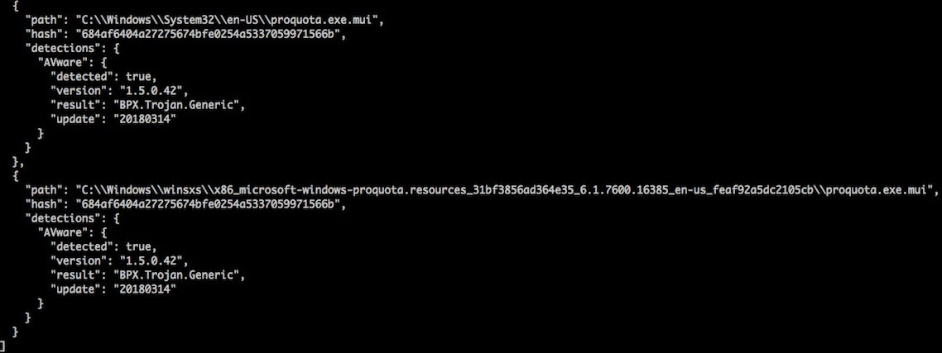
Support vtscan for Windows
The previous implementation was uploading files to the server
We can use file checksums instead
Add multiple file checksums in one query to save the round-trip time
Notes:
Chi

Slide 11
Release Schedule
Sprint 5
Replace the remote API for vulnscan with local database query
For vtscan, use cache to solve the lower efficiency problem caused by API throttling (4 queries/min)
Store the JSON results in a shared storage space (NFS or OpenShift Swift)
Implement the chosen scaling solution (Celery-based multi-processing on multiple VMs)
Sprint 6
Combine results from virus scan, CVE search, disk information, etc. to form complete results for image
Define structure/information (threat level) included
(nice to have): Generate a user friendly report based on the scanning result (data visualization)
Sprint 7
Testing
Notes:
Hao

Slide 12
Challenges for the Docker Solution
Challenges on setting up Docker
Complicated library requirements for our program
Will libguestfs work as well in a container as in VM?
Mounting NFS to docker image
Each pod will access different directory path in the NFS
Can we setup a NFS with OpenShift?
The setup cannot be too complicated for Trilio’s system admin to deploy
Our mentor suggested to go with VMs + Multi-processing solution
Notes:
Hao Wu

